Slide 1

Cyberinfrastructure for Intelligent Water Supply (CIWS) Data Visualization Challenge
Jeffery S. Horsburgh and the CIWS Team
Utah Water Research Laboratory
Department of Civil and Environmental Engineering
Utah State University

Slide 2
We all use water
How much?
When?
For what purpose?
It’s a limited resource and we live in a dry state with a rapidly growing population.

Slide 3
Water Data
Your city or water provider records your water use to send you a bill
Monthly?
Quarterly?
What if we could make measurements with very high temporal resolution to reveal water use behavior?

Slide 4
The Challenge
Given high temporal resolution water use data:
What useful information can you extract from the full resolution data to provide to:
Water consumers – who might change their behavior
Water providers – who might be able to more efficiently manage water
Researchers – who are interested in both behavior and efficient water management

Slide 5
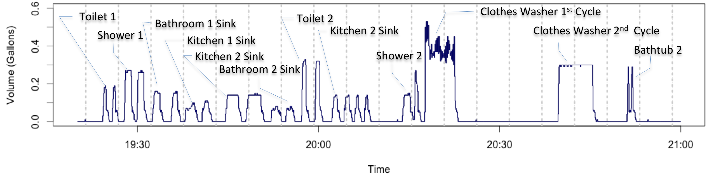
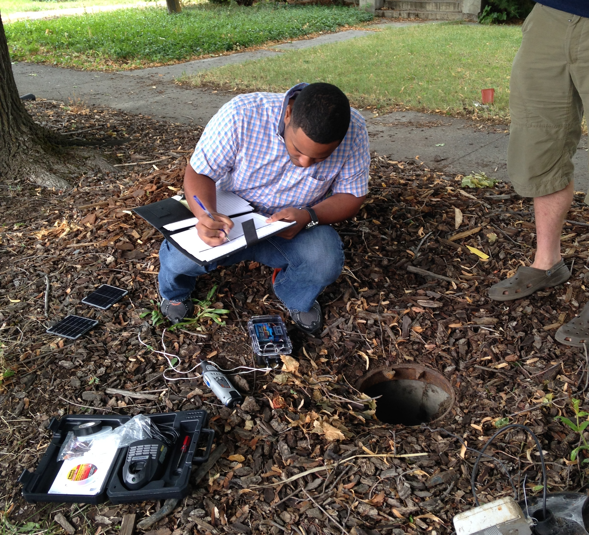
Smart Metering
High frequency data enables:
Identifying and characterizing individual water end uses
Providing information to utilities to better manage water demand
Providing feedback to water users
Estimating water-related energy use

Slide 6
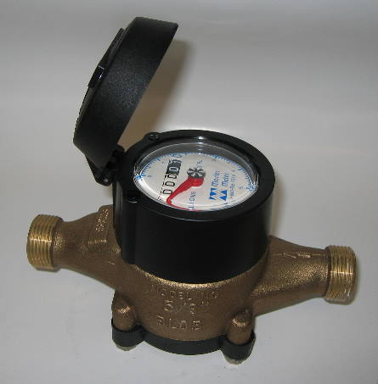
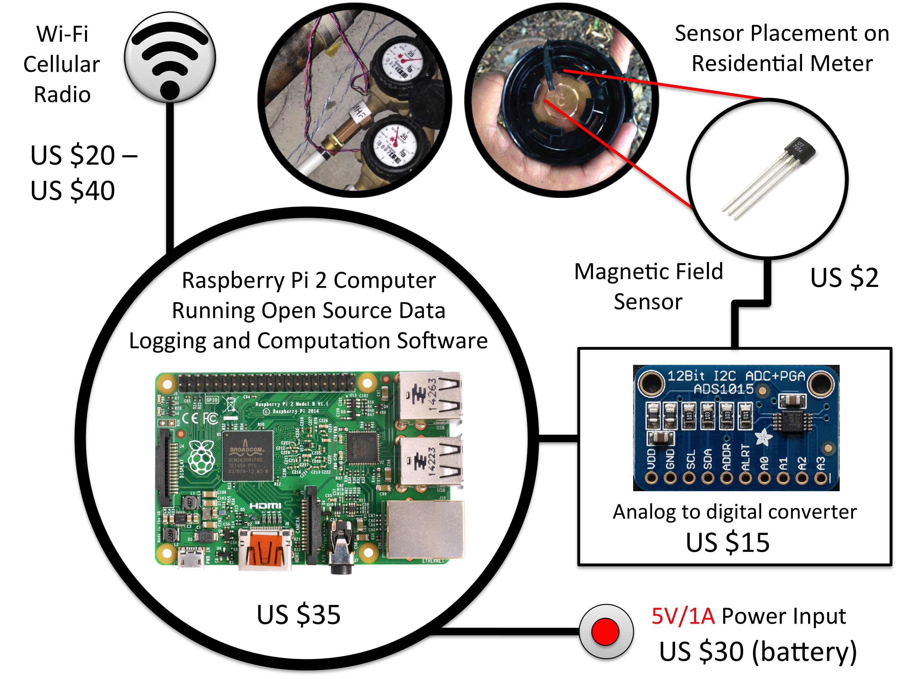
Making Existing Meters Smarter
+
Hypothesis: Computation and disaggregation of individual water use events at the data collection site can effectively “shrink” the Big Data produced by smart meters, overcoming storage and communication bandwidth limitations and providing more timely, decision-relevant information.

Slide 7
The Challenge Datasets
High-resolution (1 second) water flow measurements for 4 buildings in USU’s Living Learning Center
Hot water supply
Hot water return
Cold water supply
High-resolution (4 second) water flow measurements for 1 residential household

Slide 8
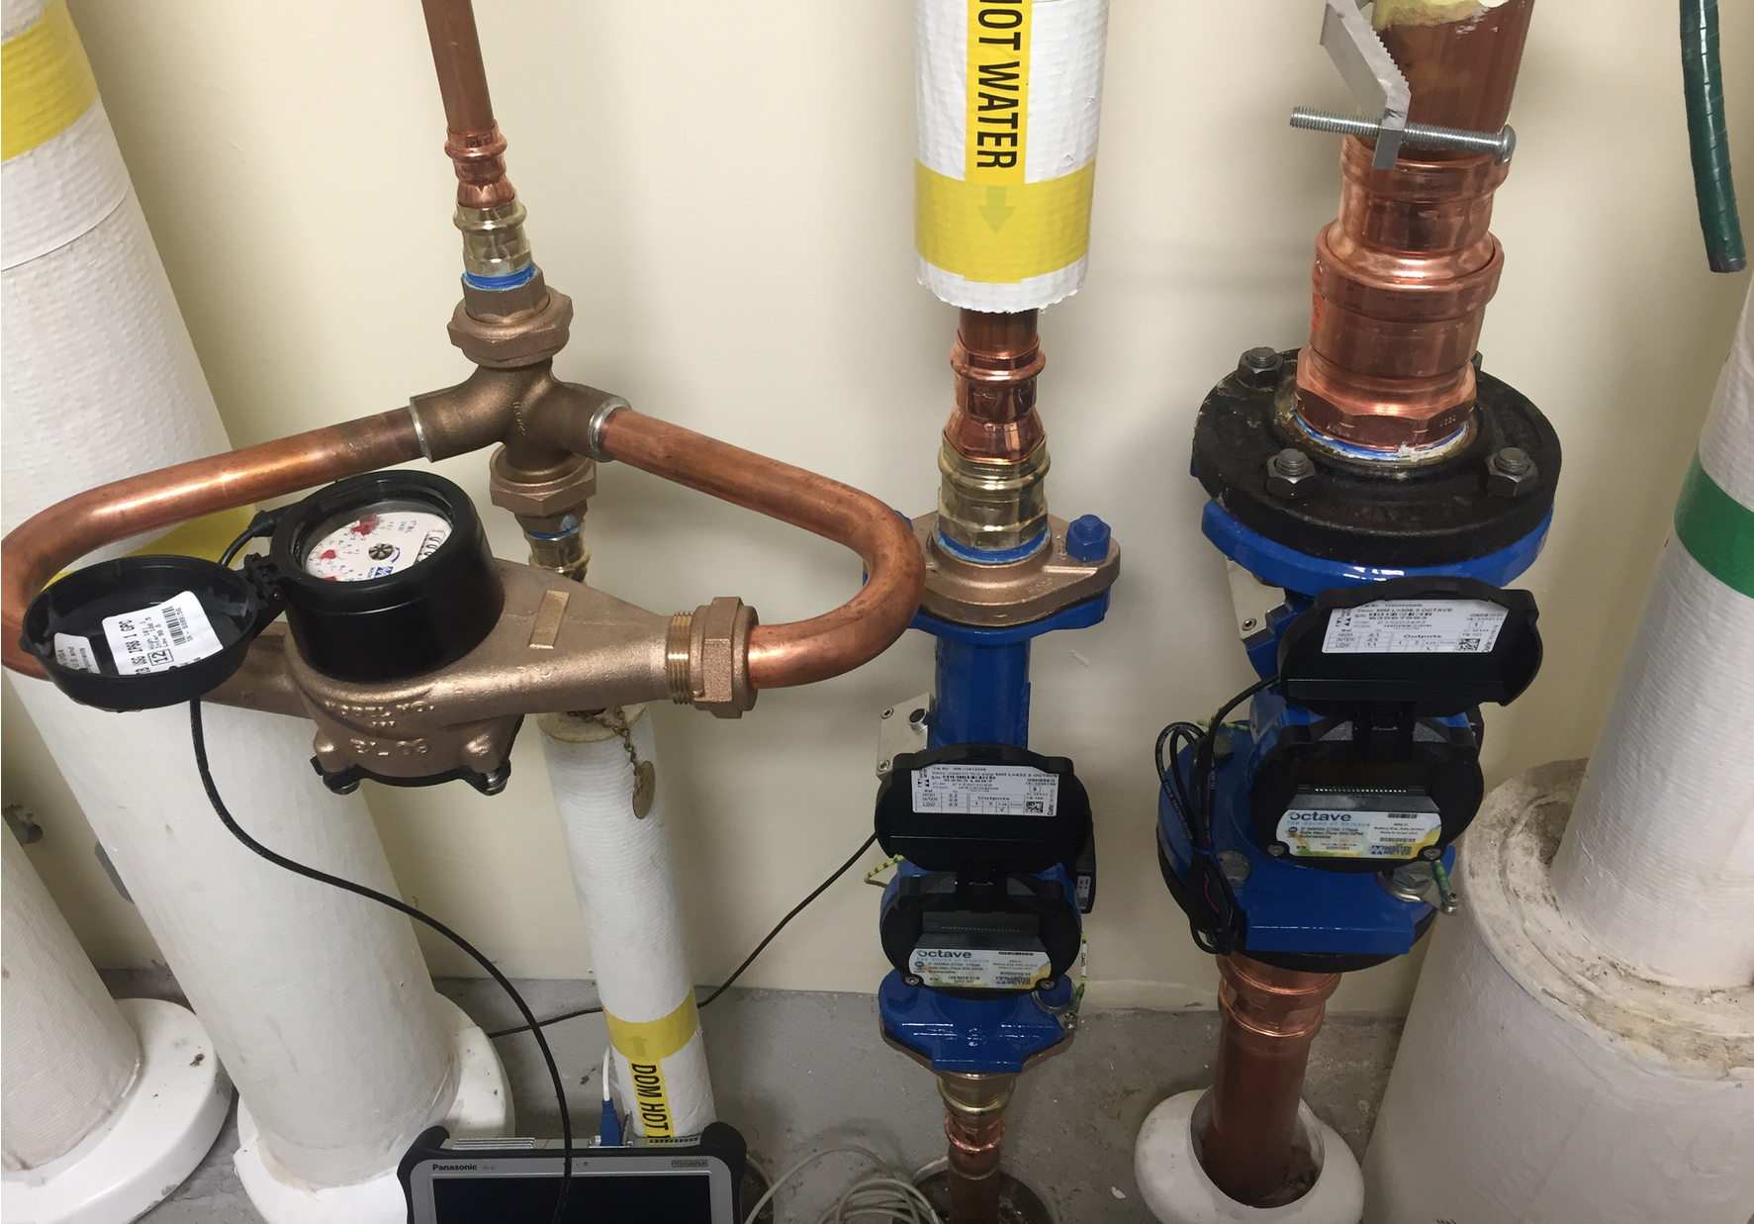
USU’s Living Learning Center
3 Meters:
Hot water supply
Hot water return
Cold water supply
Observations every 1-second
Cold Use = Cold Supply
Hot Use = Hot Supply – Hot Return
Total Use = Hot Supply + Cold Supply – Hot Return

Slide 9
USU’s Living Learning Center

Slide 10
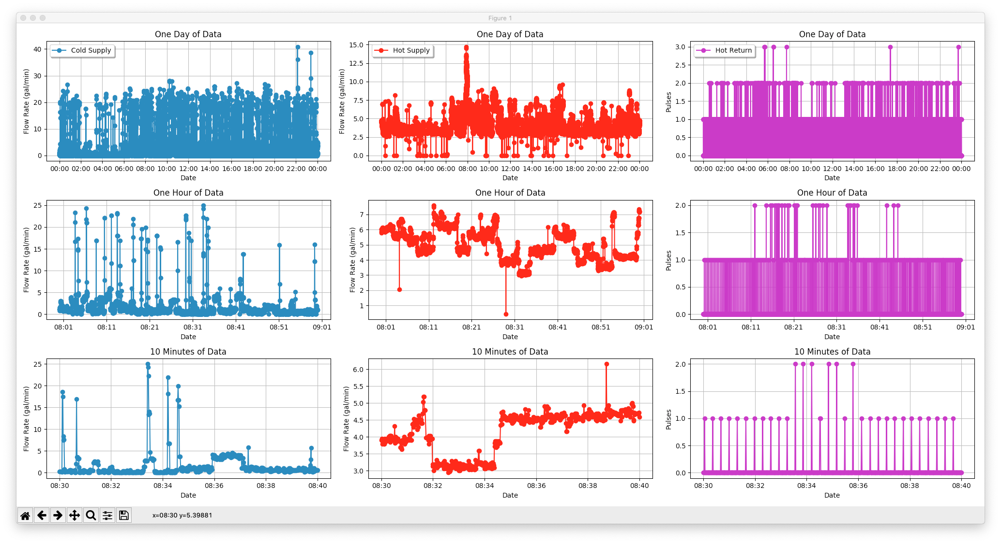
LLC Data

Slide 11
Single Family Residential Data
Data for a single home
Indoor + outdoor water use
Observations made at the water meter
Pulse count recorded every 4 seconds

Slide 12
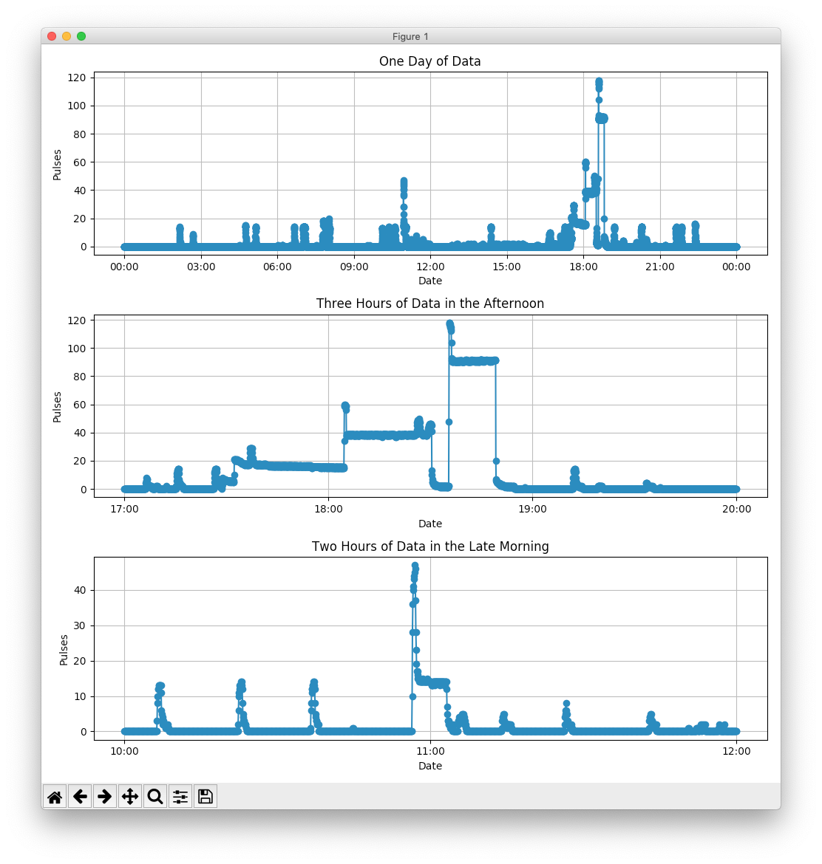
Single Family Residential Data

Slide 13
We challenge you…
To develop innovative ways to analyze and visualize the data
As an audience, you may focus on:
Us as water researchers
Water providers who want to efficiently manage water
Water consumers who want to save money

Slide 14
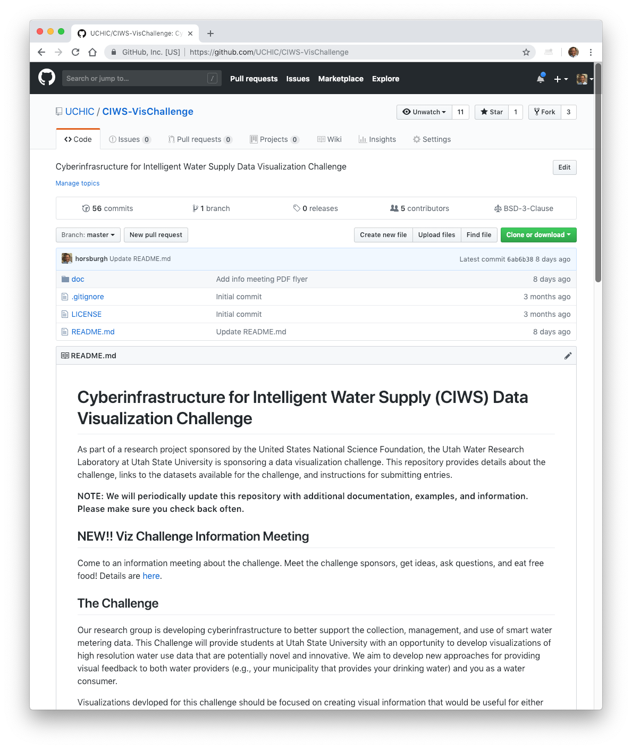
Challenge Details
Everything you need is in GitHub
Prizes: 1st ($500), 2nd ($300), and 3rd ($200) place in two categories:
Single family residential
Multi-unit residential building
Submission Deadline: Friday March 1 at midnight!
https://github.com/UCHIC/CIWS-VisChallenge

Slide 15
Examples!

